Slide 1
Class Diagrams
Logic University

Slide 2
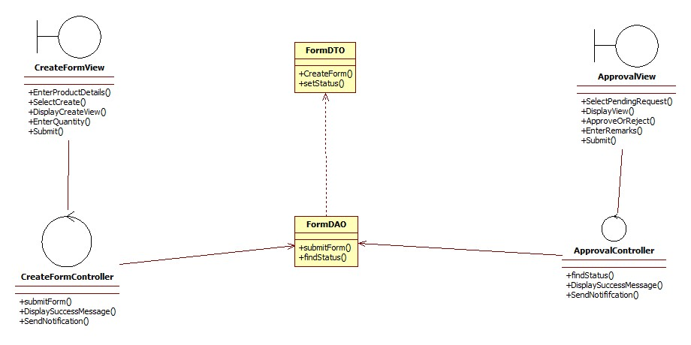

Slide 3
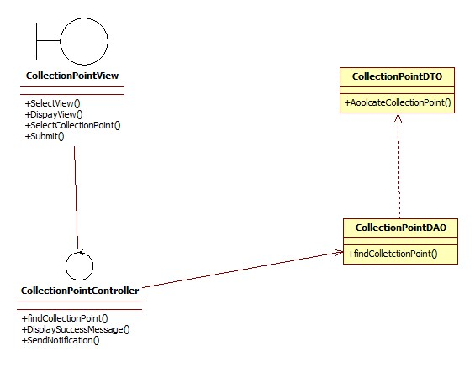

Slide 4
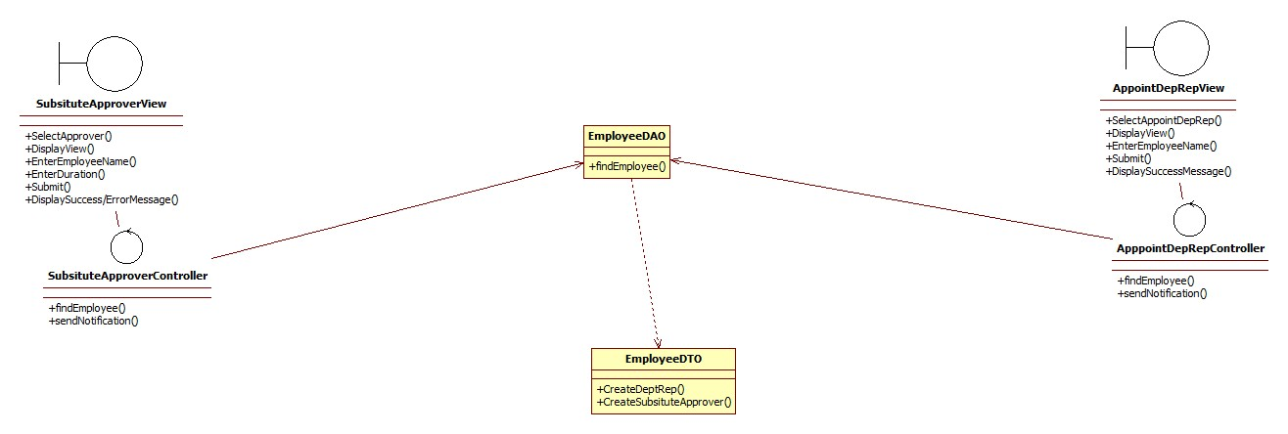

Slide 5
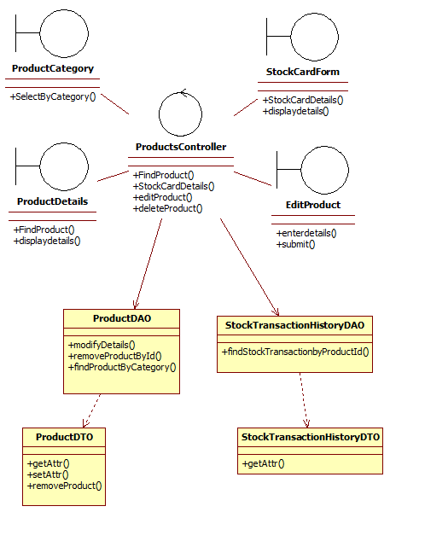

Slide 6
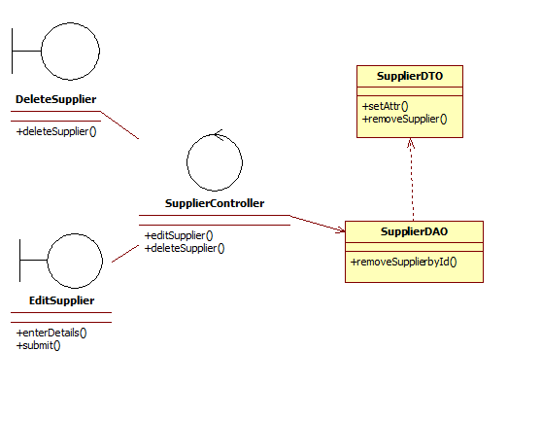

Slide 7
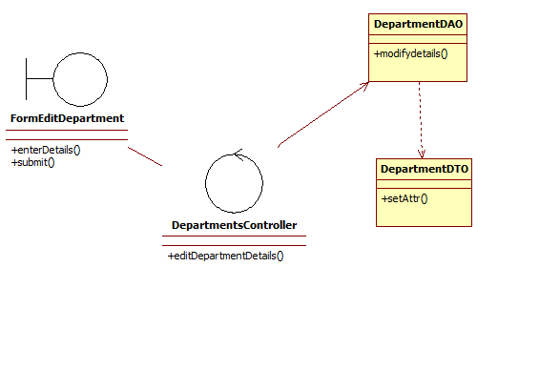

Slide 8
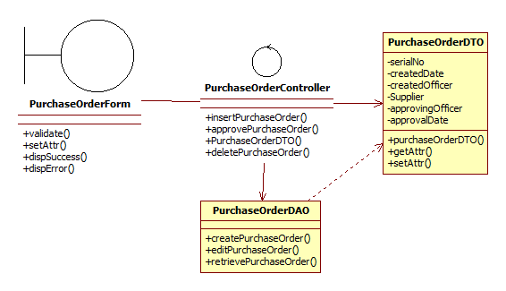
Notes:
Purchase order Class Diagram (Based on Sequence Diagram prepared)

Slide 9
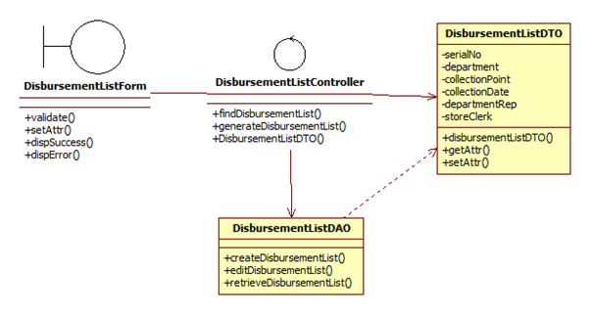
Notes:
Disbursement List Class Diagram

Slide 10
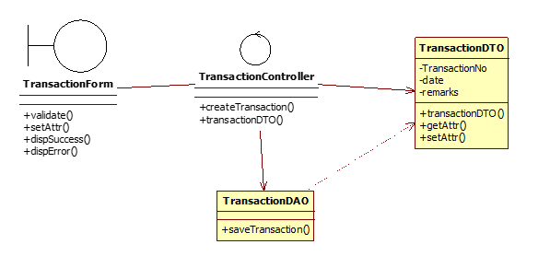
Notes:
For update item Qty

Slide 11
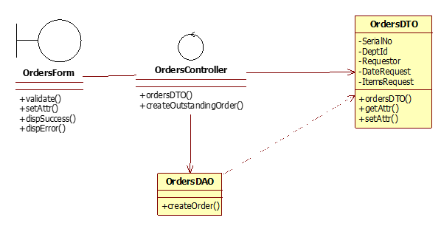
Notes:
For create outstanding order

